Slide 1
Python - Database Interactions

Slide 2
Course outline
Evaluate database and Python interactions
Use Python modules to connect to a relational database
Use Python modules to interact with a relational database
Explore CRUD operations using Python and relational database
Use Python modules to connect to a non-relational database
Explore CRUD operations using Python and non-relational database

Slide 3

Contents
Python modules to connect to a relational database
Python modules to interact with a relational database
CRUD operations using Python and relational database
Python modules to connect to a non-relational database
CRUD operations using Python and non-relational database

Slide 4
Python modules to connect to a relational database
Python module which is used to connect to Microsoft sql server i.e relational database is pyodbc
It can be installed using the command
Pip install pyodbc
What is a relational database?
It is a kind of database where the data is organized into tables and tables consist of mainly rows and columns where rows are called the records and columns are called as fields.

Slide 5
Prerequisites to work with pyodbc
Download Microsoft sql server management studio using the below link
https://docs.microsoft.com/en-us/sql/ssms/download-sql-server-management-studio-ssms?view=sql-server-ver15
Connect to SQL server after downloading
https://www.youtube.com/watch?v=b8Bg_QPpYR8

Slide 6
Working with pyodbc modules
Prepare a connection string
Set up the query to be executed
Create a connection using the connection string and the method pyodbc.connect()
Create a cursor
Execute the cusor
Fetch and store the results
Close the cursor

Slide 7
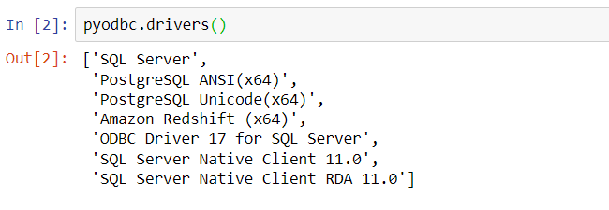

Prepare a connection string
The connection string consists of the driver name, server name, database name, trusted connection parameters for the windows authentication Where Driver name has be taken from the set of drivers present in the system. Ex: SQL Server
Pyodbc.drivers() give all the possible drivers present in the system

Slide 8

Set up the query to be executed
Write the query which you want to execute and store it in a string
In the above query we are trying to retrieve all the records from the table named ‘Car’

Slide 9

Creating a connection
Create a connection using the connection string and the method pyodbc.connect()
Pyodbc.connect() method takes the connection string as input and the connection is established

Slide 10


Creating and executing a cursor
Creating a cursor:
Here the cursor is created or initiated
Executing the Cursor:
Cursor.execute() takes the query as input and the cursor is executed

Slide 11
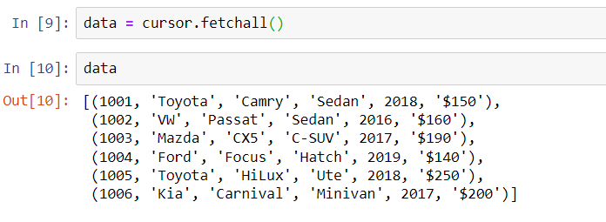

Fetch and store the results
The cursor.fetchall() fetches all the records of the query. And the data is printed in the below cell
Close the cursor:
Cursor.close() method closes the cursor

Slide 12
CRUD operations on the relational database
CRUD operations are nothing but the basic operations on any database .
CREATE
READ
UPDATE
DELETE
The above process remains the same but only difference would be the query.
Let’s see the following in terms of examples:

Slide 13
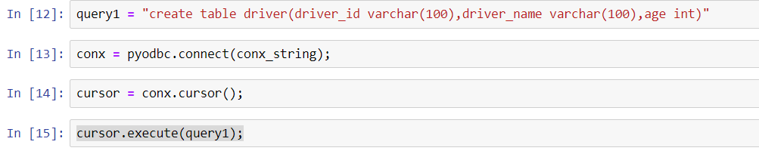
Create and read operation
Here a query is written to create a table named driver with driver_id ,driver_name,age as fields
Create a connection then create a cursor and finally execute the cursor. Next we shall check if the table driver has been created or not

Slide 14
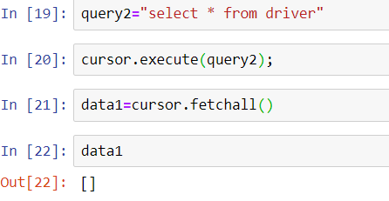
Create and read operation
Here we have written a query to fetch the results from the driver table but as we have not added any records to the table we find that the data1 is empty list. Now lets insert some records and test it

Slide 15
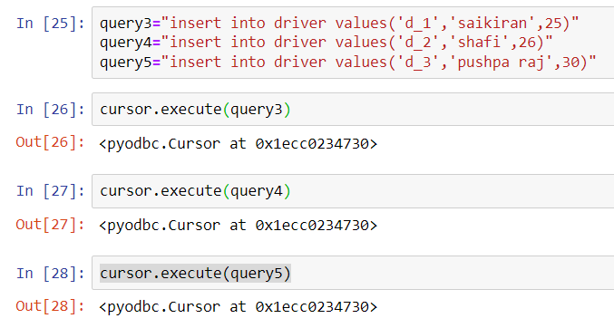
Create and read operation
Here we add three values with the help of the insert statement and execute the cursors for the respesctive queries then next we shall see if the results are reflected or not

Slide 16
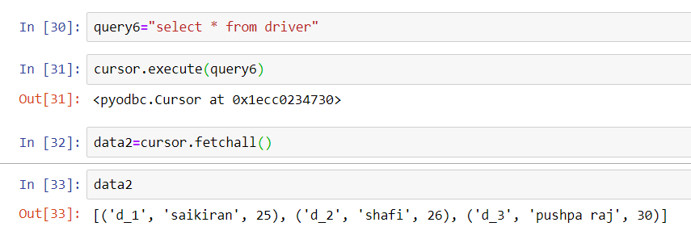
Create and read operation
Here we can have written a query to find the records inserted in the table driver.
We can see that in data2 we have successfully retrieved the records which we have inserted previously

Slide 17
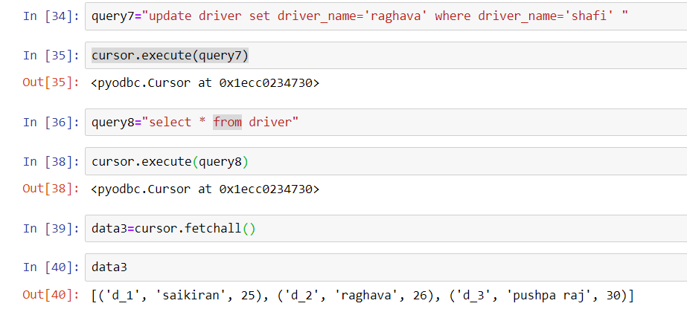
Update operation
In the above query we have updated the driver name from ‘shafi’ to ‘Raghava’ we can see that data3 the final result

Slide 18
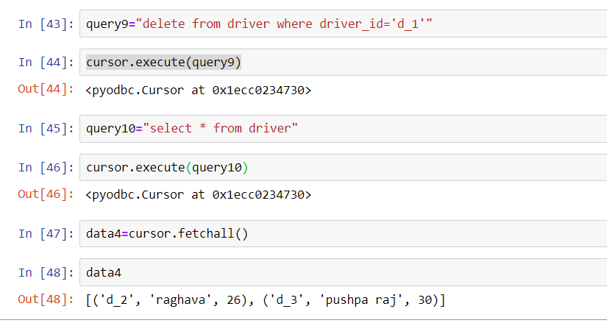
Delete operation
Here we are deleting the record who is having the driver_id as d_1. We can see that in data4 the driver named ‘Saikiran’ who is having the driver_id as ‘d_1’ has been deleted.

Slide 19
Python modules to connect to a non-relational database
There are many non-relational databases which are present like mongodb, apache Cassandra etc.
We shall see how to connect python with mongodb using the module Pymongo
It is installed using the command
pip install pymongo
What is non relational database?
It is the type of the database where it is used for handling semi-structured or un-structured data

Slide 20
Prerequisites
We have to install the mongodb software from the below link one is .msi installer the other one is mongodb compass
After you download both the things then put the connection url as
mongodb://localhost:27017/
In the mongodb compass and connect to it (it is nothing but your localhost)
https://www.mongodb.com/try/download/community?tck=docs_server&_ga=2.109548672.407252487.1641376327-725431448.1641376327
https://docs.mongodb.com/compass/master/install/

Slide 21
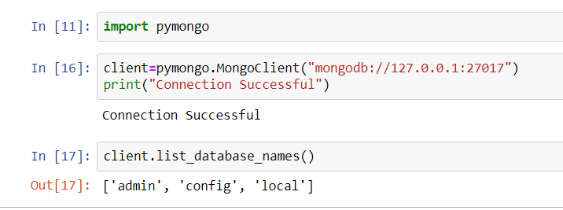
Connection to mongodb using pymongo
Here after we install the pymongo module using pip install pymongo
We import the pymongo and create a connection with the help of pymongo.
MongoClient(connectionstring) method here the connection string is the local host
We test which databases are present using the list_database_names() method

Slide 22
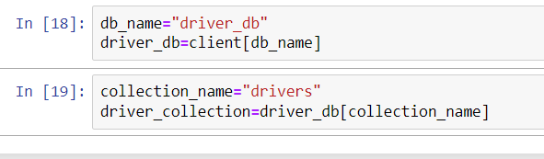
Creation of database and collection
We will create database and collection and the start doing our CRUD operations
Here we have created a driver database named driver_db in the client which have created previously
And collection named drivers to store the documents related to drivers
It is stored in the variable driver_collection

Slide 23
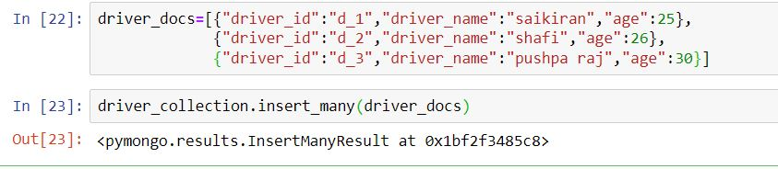
CRUD operations using pymongo
Create operation
In the above we are creating a documents of drivers and inserting them into the collection of drivers.
Insert_many() is the function which is used to insert many records at once into the collection let us check if we successful in inserting the documents into the collection

Slide 24
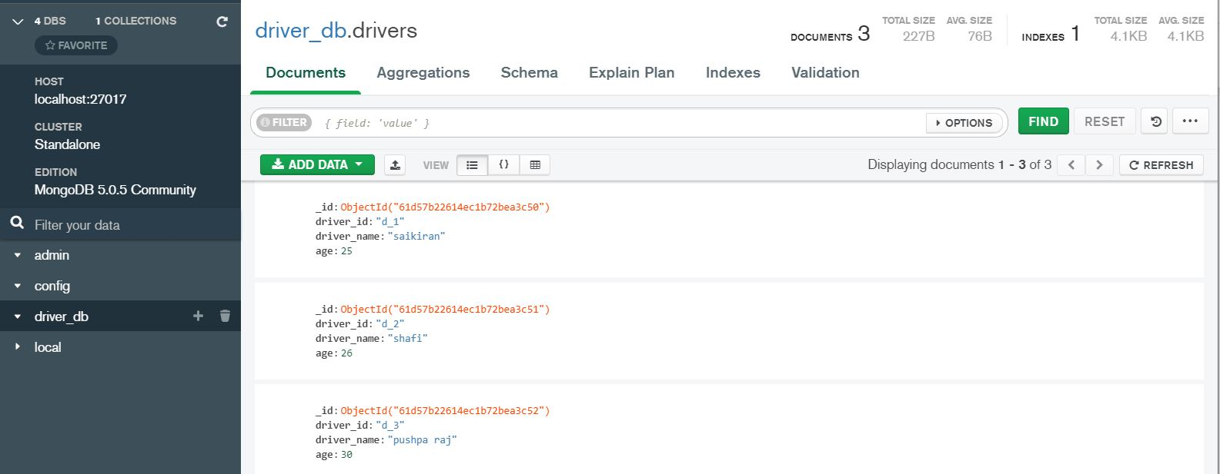
CRUD operations using pymongo
Here we can see that in our mongo db compass we have the records inserted.

Slide 25
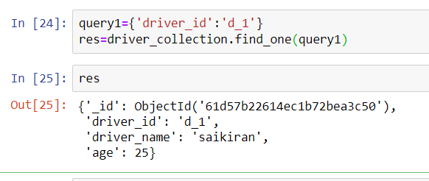
Retrieve operation
Here we are trying to retrieve the driver_id is d_1 and find_one(query) is the function which is used to retrieve one document from the collection and we can see that the result is shown in res

Slide 26
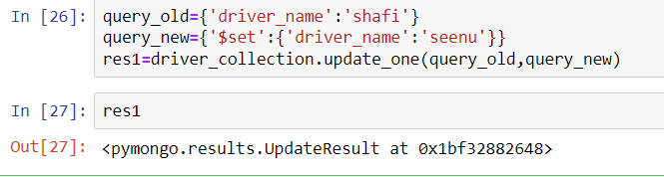
Update operation
We are now updating the driver name from shafi to seenu
Update_one (old_query,new_query) is the function which takes the old data and the new data and makes the following update.Updates only one record. We shall see if get the aspired result..

Slide 27
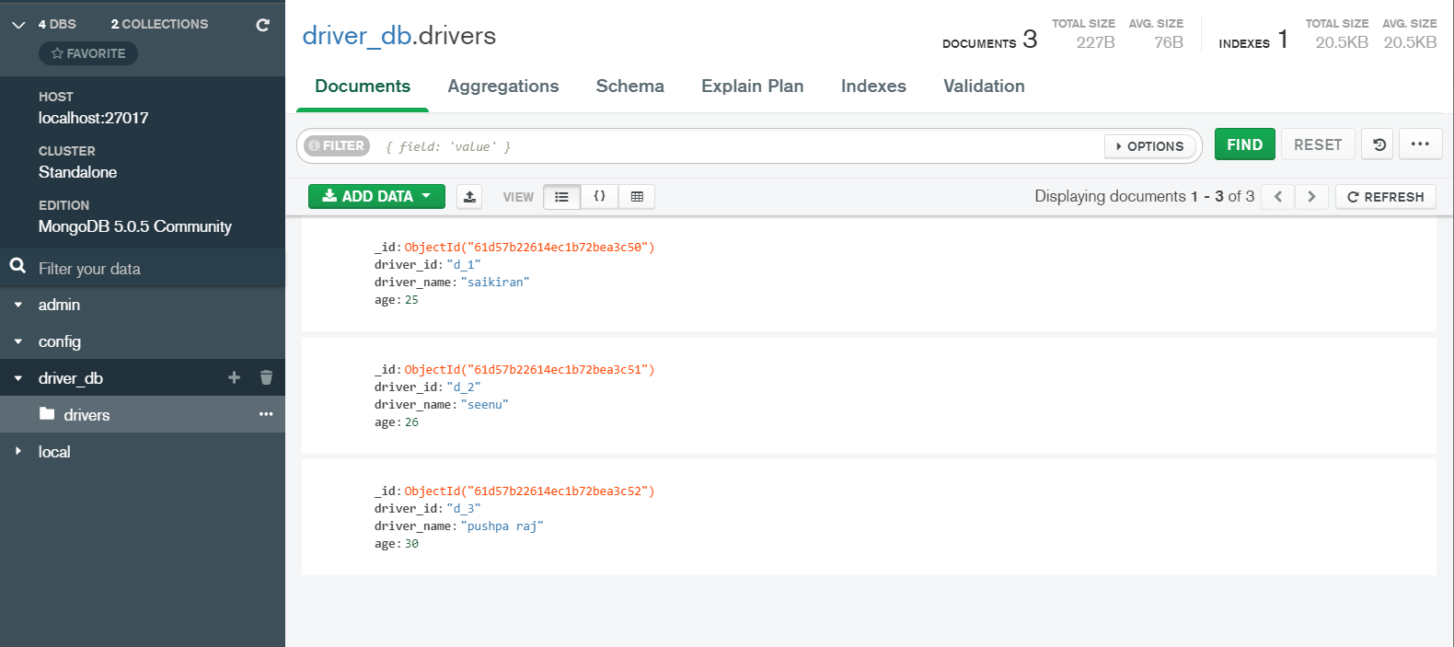
Update operation
In the above we can see that the driver name has been changed from ‘shafi’ to ‘seenu’

Slide 28
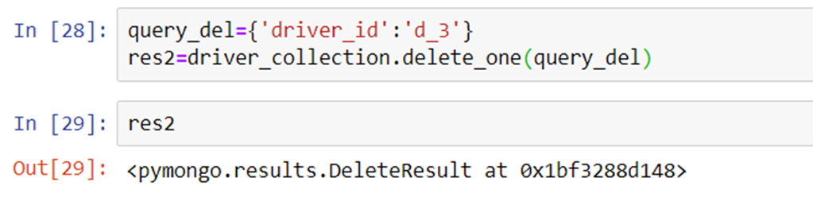
Delete operation
Here we are deleting the driver who has the driver_id as d_3 so the drier named ‘pushpa Raj’ should be deleted.
Delete_one(present_value) takes the parameter as present value and deletes the only document corresponding to the query.
Lets see if we have achieved the result or not

Slide 29
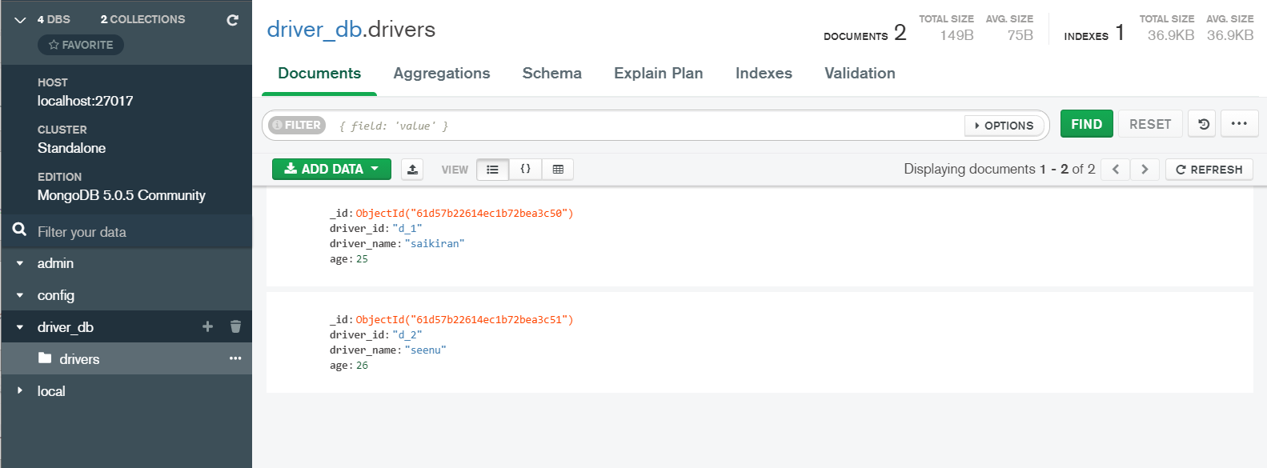
Delete operation
Here we can see that the driver_id is ‘d_3’ has been deleted and we can see only two documents present In the collection

Slide 30
Assignment
Apply CRUD operations on the adventureworks2019 database file using pyodbc
Below link is given for the .bak file(adventureworks2019.bak)
https://docs.microsoft.com/en-us/sql/samples/adventureworks-install-configure?view=sql-server-2017&tabs=ssms
Apply CRUD operations on the list of documents(collection) using pymango
Doc1=[{"fruit": "Apple", "size": "Large", "color": "Red“},
{"fruit": “Mango", "size": “Medium", "color": “Yellow“},
{"fruit": “Guava", "size": “small", "color": “Green“},]

Slide 31
Summary

Slide 32
Q&A

Slide 33
References
https://nbviewer.org/github/israel-dryer/Python-Tutorials/blob/master/pyodbc-tutorials/Connect-To-Microsoft-SQL-Server.ipynb
https://www.youtube.com/watch?v=Vm2fHhP4SVE
https://medium.com/analytics-vidhya/crud-operations-in-mongodb-using-python-49b7850d627e

